Slide 1


Tiffany Simms Lindsey
March 25, 2024

Slide 2

Outline
Executive Summary
Introduction
Methodology
Results
Conclusion
Appendix

Slide 3
Executive Summary
Summary of methodologies
Data Collection: API and Web Scraping
Exploratory Data Analysis: SQL Queries and Data Visualization
Visual Analysis: Folium Lab and Interactive Dashboard
Predictive Analysis:
Logistic Regression
Support Vector Machine
Decision Tree Classifier
K-Nearest Neighbor
Summary of all results
Trend of launch success rate is overall positive to 2020
The best method for predictive analysis was determined to be the Decision Tree Classifier

Slide 4
Introduction
Project background and context
Commercial space travel is a growing market with several companies using manned and unmanned spaceflights to accomplish a wide variety of goals, including satellite placement, suborbital spaceflights for civilians, and sending spacecraft to the International Space Station. Rocket launches are typically performed in two stages. Stage 1 is where the majority of thrust comes from, and Stage 2 utilizes more controlled thrust to get the payload to its destination (orbit, ISS, etc). SpaceX is perhaps the most successful of the companies performing these tasks, with rocket launches costing approximately 62% less than other providers. One reason SpaceX is successful is that their rocket launches are relatively inexpensive because they can reuse the first stage. If we can determine if their first stage will land successfully and be able to be reused, we can determine the approximate cost of a launch.
Problems you want to find answers
What factors influence the success of a launch and ability to reuse Stage 1?
What method will best predict the success of a launch that has not yet occurred?

Slide 5

Section 1

Slide 6
Methodology
Executive Summary
Data collection methodology:
Performed request to SpaceX AP and web scraping of Wikipedia tables
Perform data wrangling
Data was grouped by launch site, orbit, and landing outcomes (0=fail, 1 = success)
An average of landing outcome classes give us a success rate
Perform exploratory data analysis (EDA) using visualization and SQL
Perform interactive visual analytics using Folium and Plotly Dash
Perform predictive analysis using classification models
Classification models are built by creating a testing and training data set from the data available. The training set is used to train the model and the testing set is used to test the model. Each model is evaluated by fitting the training data to the model and testing the model’s accuracy. A confusion matrix can help see different features of the data for each model.

Slide 7
Data Collection
Made request to SpaceX REST API to pull SpaceX launch data
Provides information about launch date, booster version, payload mass, orbit, launch site and coordinates, launch outcome, details about rocket used, and whether the rocket was able to be reused
Web scraping with Beautiful Soup was used to retrieve data from Wikipedia tables
Provides information on launch date, flight number, launch site, booster version, payload and payload mass, orbit, customer, launch outcome, and booster landing
SpaceX REST API
Data returned in JSON format
Data normalized into CSV file
Data consolidated for wrangling
Web Scraping from Wikipedia
Data extracted using Beautiful Soup
Data normalized into CSV file

Slide 8
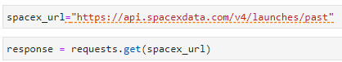
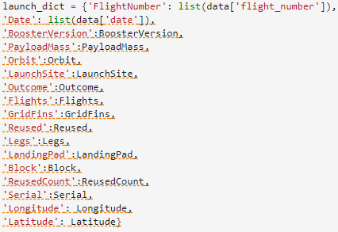
Data Collection – SpaceX API
API to SpaceX REST API
Convert API response to JSON
Clean data and create data dictionary
Use mean to replace missing data for payload mass
Export data to CSV file
API Data Collection Jupyter Notebook

Slide 9
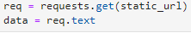
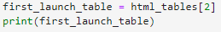
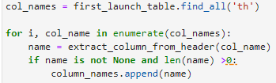
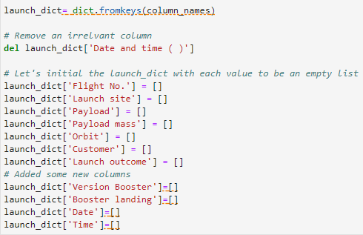
Data Collection – Web Scraping
Pull text data from web page
Create Beautiful Soup object
Find all tables available
Pull data from launch table and find all column names
Create data frame by parsing HTML launch tables
Export data to CSV file
Web Scraping Jupyter Notebook

Slide 10
Data Wrangling
Data Wrangling Jupyter Notebook
Extract data from combined CSV file
Identify missing values for each attribute
Identify which columns are numerical and categorical
Calculate launches for each site
Calculate launches for each orbit
Calculate number and occurrence of mission outcome for each orbit
Create landing outcome column (Class)
Use Class column to show a Success Rate
Export to CSV file

Slide 11
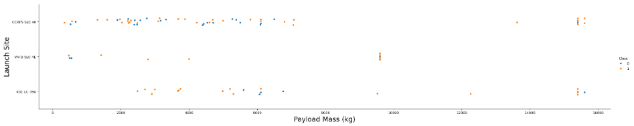
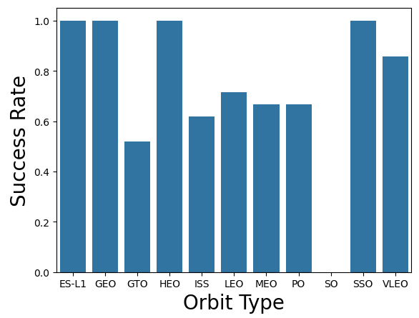
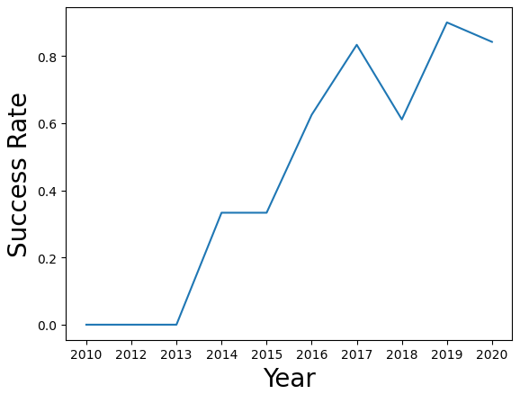
EDA with Data Visualization
Plotted scatter charts to explore relationships between variables
Plotted a bar chart of Orbit Type and Success Rate to see which orbit types are more successful
Plotted Success Rate over time
Data Visualization Jupyter Notebook

Slide 12
EDA with SQL
Names of unique launch sites
Launch sites that begin with CCA
Total payload mass carried by NASA
Average payload mass carried by booster version F9 v1.1
Date of first successful landing outcome (ground pad)
Booster versions which have success in drone ship
Total number of successful and unsuccessful mission outcomes
Names of booster versions which have carried the maximum payload mass
Records which had failed landing outcomes in drone ship
Rank of landing outcomes between 6/4/2010 and 3/20/2017
EDA with SQL Jupyter Notebook

Slide 13
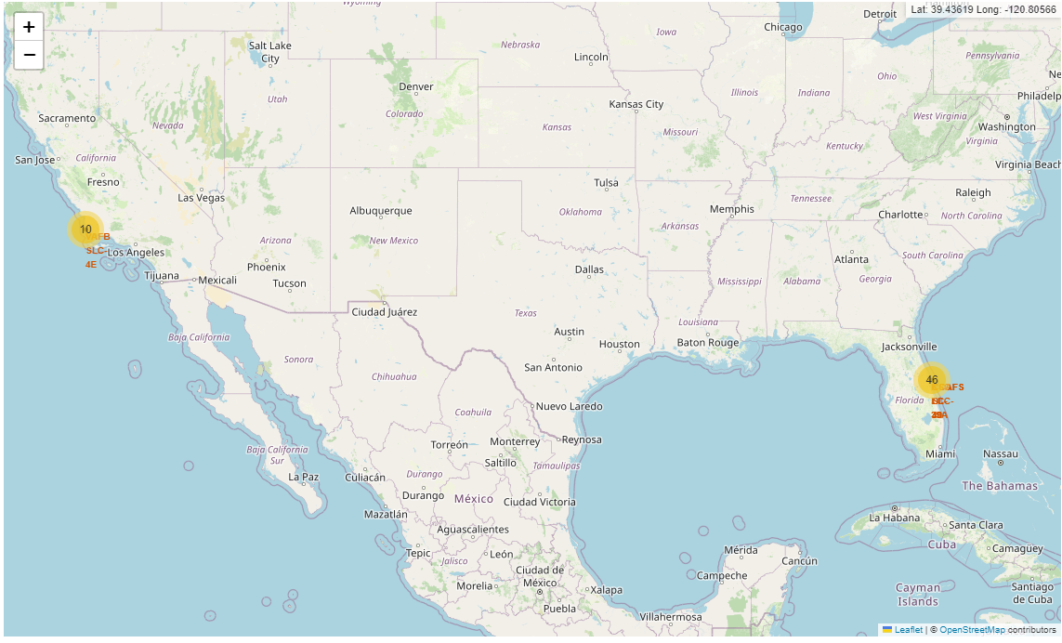
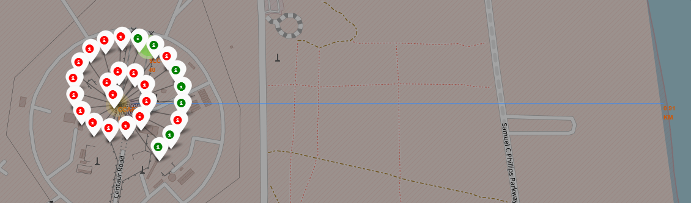
Build an Interactive Map with Folium
Launch sites were added to the map and marked
Successful and unsuccessful launch coordinates were added to the map and marked red (failures) and green (successes)
Distance to closest coastline, railroad, city, and major highway were measured using lines
Launch sites are typically close to coastlines, railroads, and highways
Launch sites studied are more than 14 miles away from the nearest city center
Interactive Map with Folium Jupyter Notebook

Slide 14
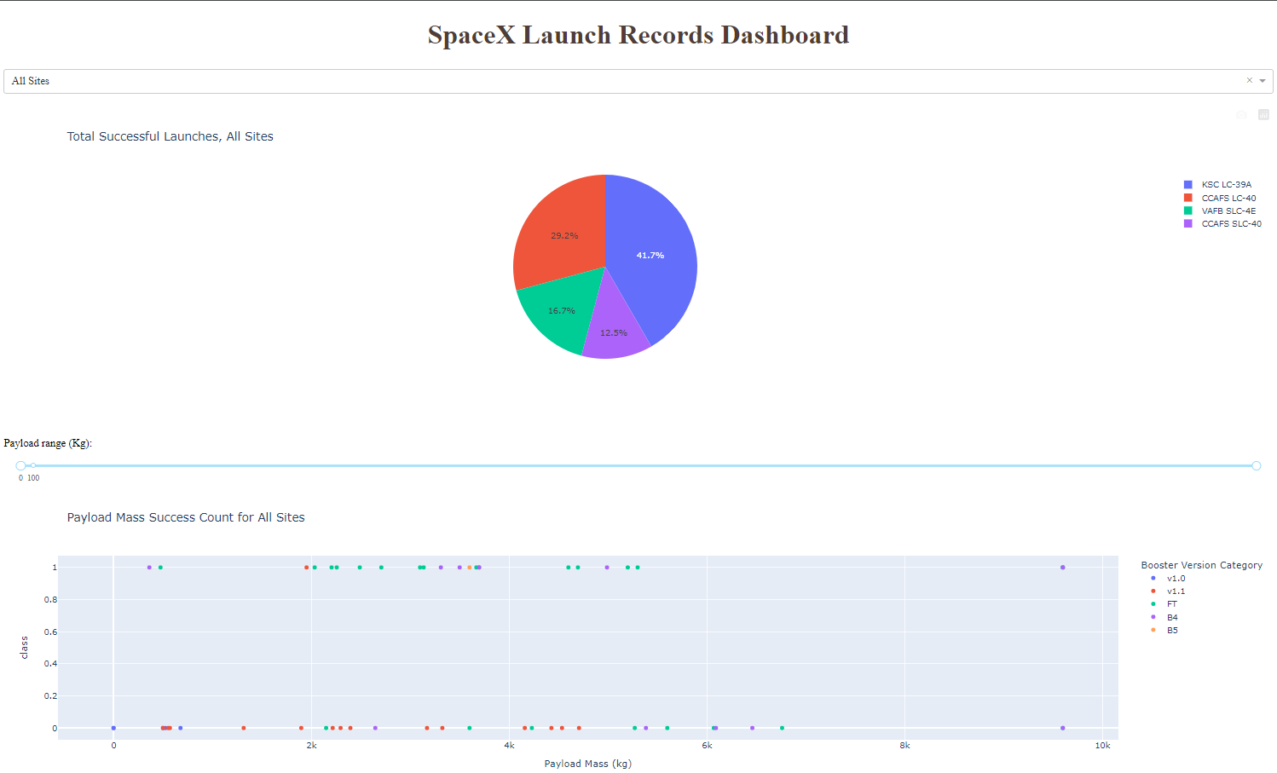
Build a Dashboard with Plotly Dash
Pie chart with percentage of successful launches filterable by site
Scatter chart showing failed and successful launches filterable by payload range, also shows booster version
Plotly Dash Python File

Slide 15
Predictive Analysis (Classification)
Several models were used to analyze the SpaceX data: Decision Tree, K-Nearest Neighbor (KNN), Logistic Regression (LR), and Support Vector Machines (SVM). Each model was evaluated individually, then results were compared to each other.
Data was split into a Training Set and a Testing Set
Data was fit to the Training Set, then accuracy was calculated for each by finding the best score.
The accuracy score was then calculated on the Test Set.
Confusion matrices were developed for each model to see which features can be easily distinguished from each other and whether there are false positives or negatives.
Predictive Analysis Jupyter Notebook
Model on Testing Set
Training data fit to model
Best parameters and score for each model determined on Training Set
Accuracy calculated on Testing Set
Confusion matrix on Testing Set

Slide 16
Results
The first successful landing for SpaceX was in December of 2015
The F9 Booster has success in drone ship and where the payload mass is between 4000 and 6000 kg
The F9 Booster has also been able to carry the maximum payload mass
Overall, success is higher when payload mass is lighter
The site KSC LC-39A has the most successful launches
The F9 Booster type FT has the most successes at payloads below 6000 kg
The best model was determined to be a Decision Tree, which had an accuracy score of 88.9%
ES-L1, GEO, HEO, and SSO orbits are the most successful

Slide 17

Section 2

Slide 18
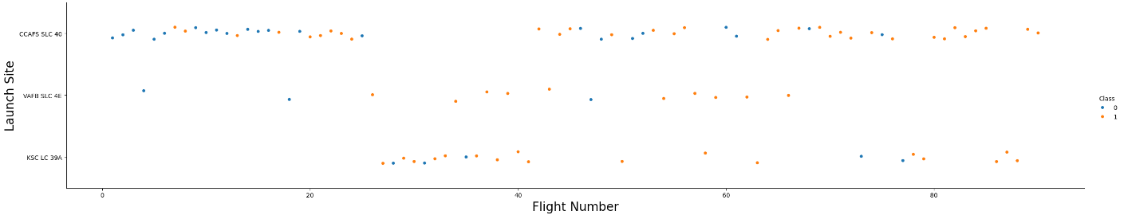
Flight Number vs. Launch Site
Flight numbers correlate with the number of launches
At most launch sites, successful launches increase in number with more launches (higher flight numbers)
CCAFS SLC-40 has had the most launches

Slide 19
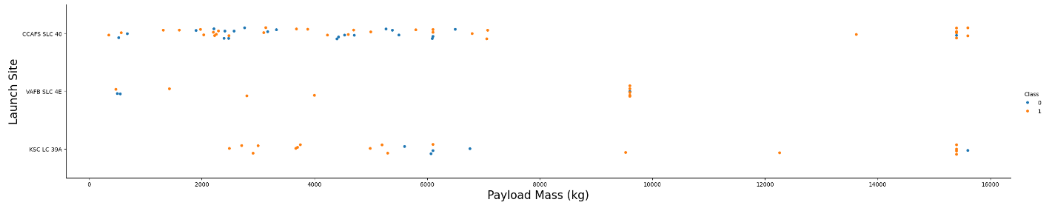
Payload vs. Launch Site
Some launch sites have more successful launch numbers with certain payload ranges
Most low payload mass launches have been performed at CCAFS SLC-40

Slide 20
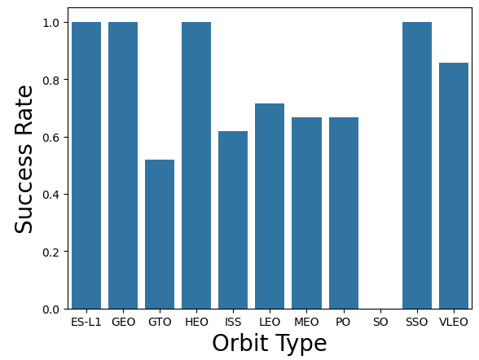
Success Rate vs. Orbit Type
Success rate can also vary depending on the orbit type
ES-L1, GEO, HEO, and SSO orbits are the most successful

Slide 21
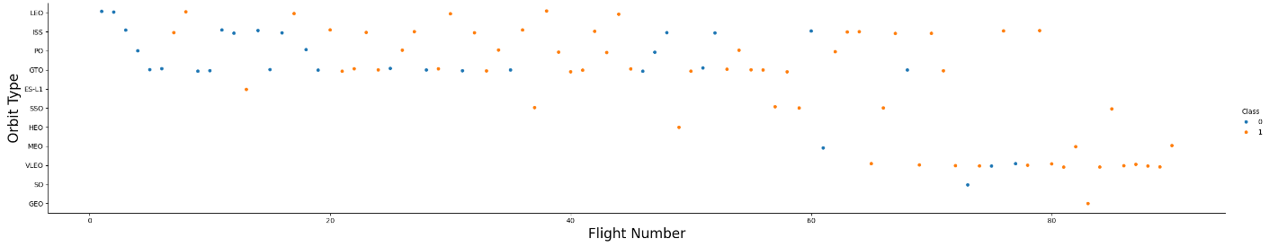
Flight Number vs. Orbit Type
Earlier flights were generally performed for LEO, ISS, PO, and GTO orbits
In recent years it has become more common to target the VLEO orbit type

Slide 22
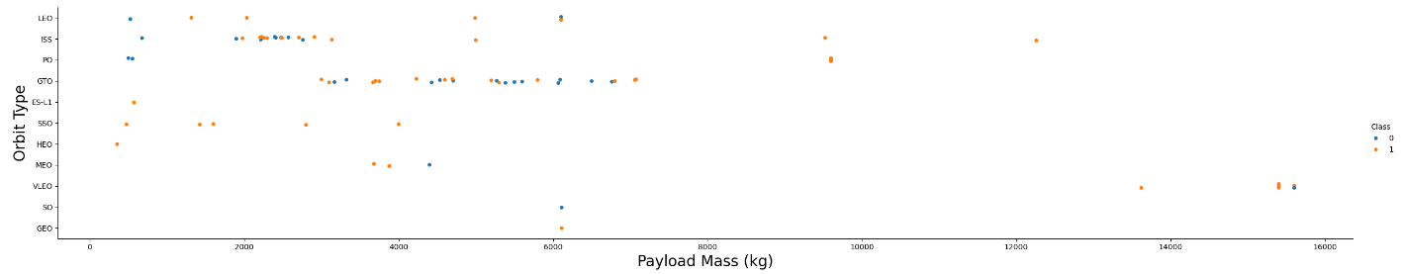
Payload vs. Orbit Type
ISS payload mass is typically around 2000 kg
GTO payload is typically between 3000 and 8000 kg

Slide 23
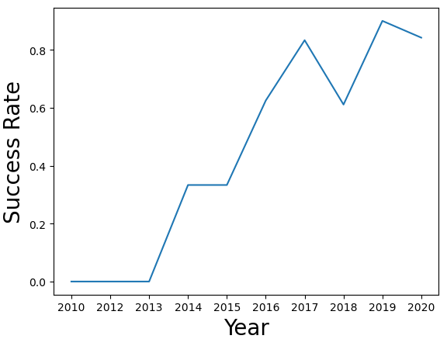
Launch Success Yearly Trend
Launch success rate has increased significantly since 2013
Since 2017, success rates have been consistently high

Slide 24
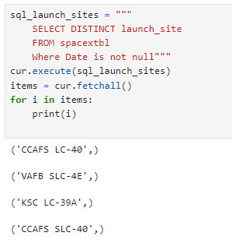
All Launch Site Names
This query returns the distinct launch site names

Slide 25
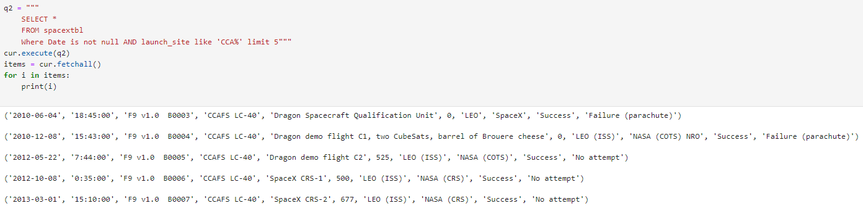
Launch Site Names Begin with 'CCA'
This query pulls the first 5 data points that have a launch site name that starts with ‘CCA’

Slide 26
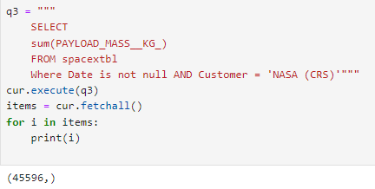
Total Payload Mass
This query calculates the total payload carried by boosters from NASA, 45596 kg

Slide 27
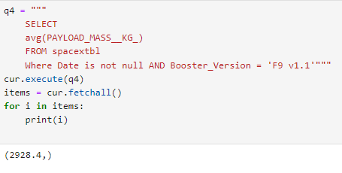
Average Payload Mass by F9 v1.1
This query calculates the average payload mass carried by booster version F9 v1.1, which is 2928.4 kg

Slide 28
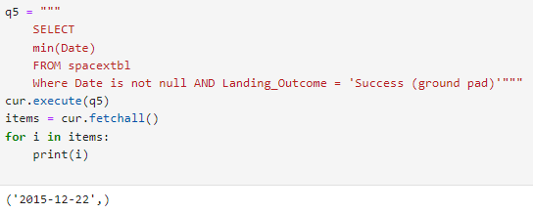
First Successful Ground Landing Date
This query looks for the date of the first successful landing outcome on ground pad, Dec 22, 2015

Slide 29
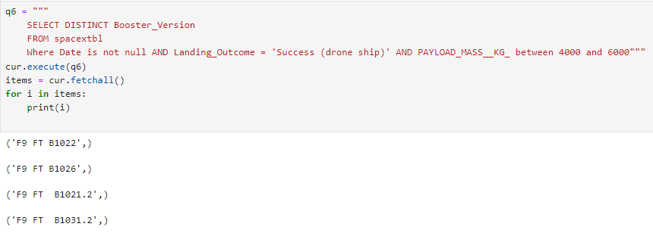
Successful Drone Ship Landing with Payload between 4000 and 6000
This query lists the names of boosters which have successfully landed on drone ship and had payload mass greater than 4000 but less than 6000

Slide 30
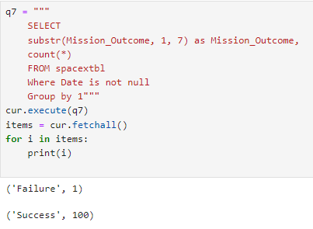
Total Number of Successful and Failure Mission Outcomes
This query calculates the total number of successful and failure mission outcomes
Failure: 1
Success: 100

Slide 31
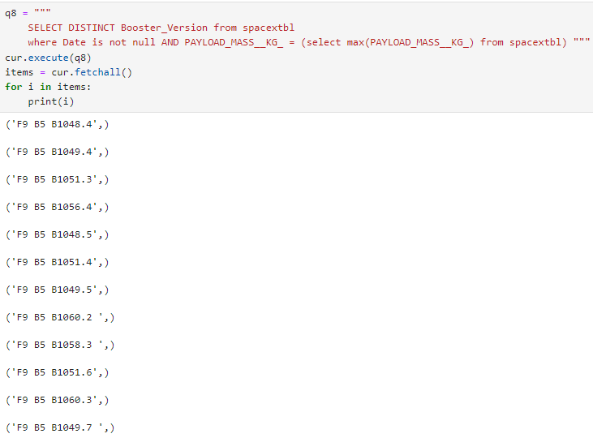
Boosters Carried Maximum Payload
This query lists the names of the booster which have carried the maximum payload mass

Slide 32
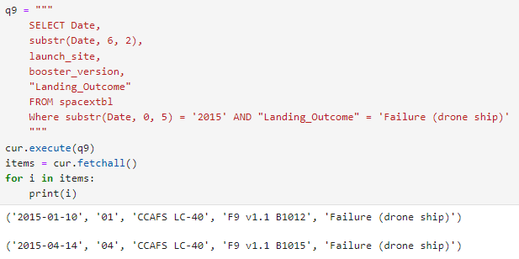
2015 Launch Records
This query lists the failed landing outcomes in drone ship, their booster versions, and launch site names for in year 2015 and returns only two entries in 2015

Slide 33
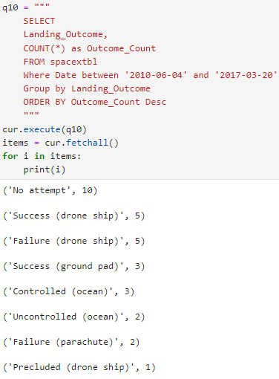
Rank Landing Outcomes Between 2010-06-04 and 2017-03-20
This query ranks the count of landing outcomes between the dates 2010-06-04 and 2017-03-20, in descending order
The highest count show no attempt for landing

Slide 34

Section 3

Slide 35
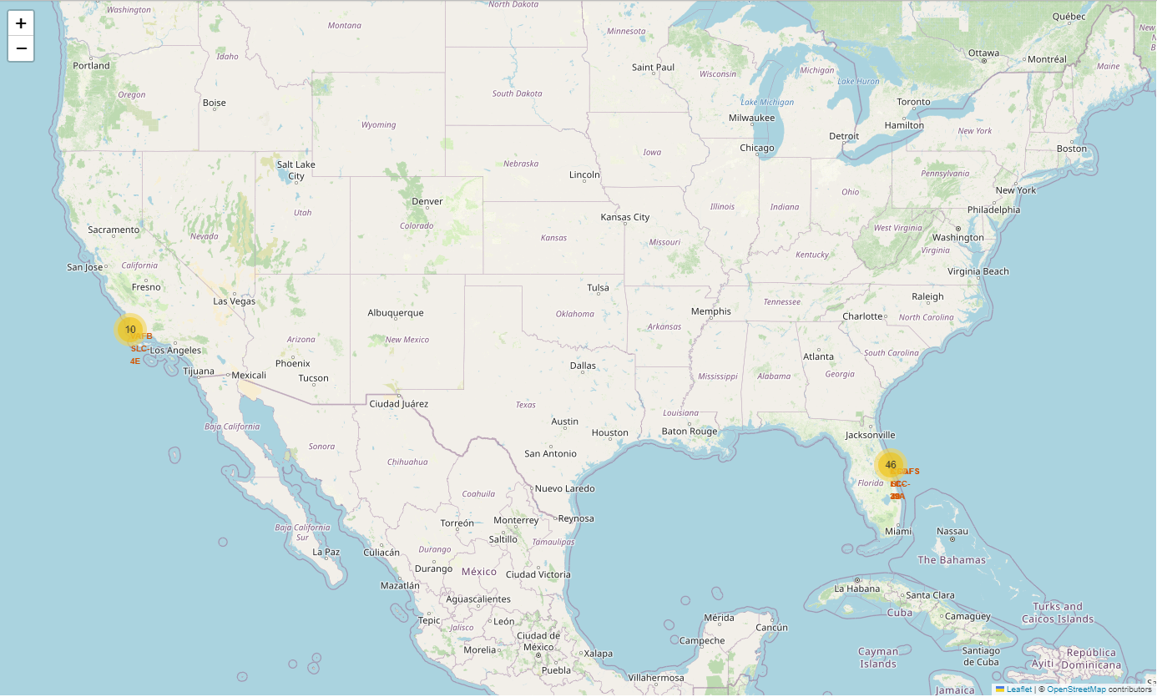
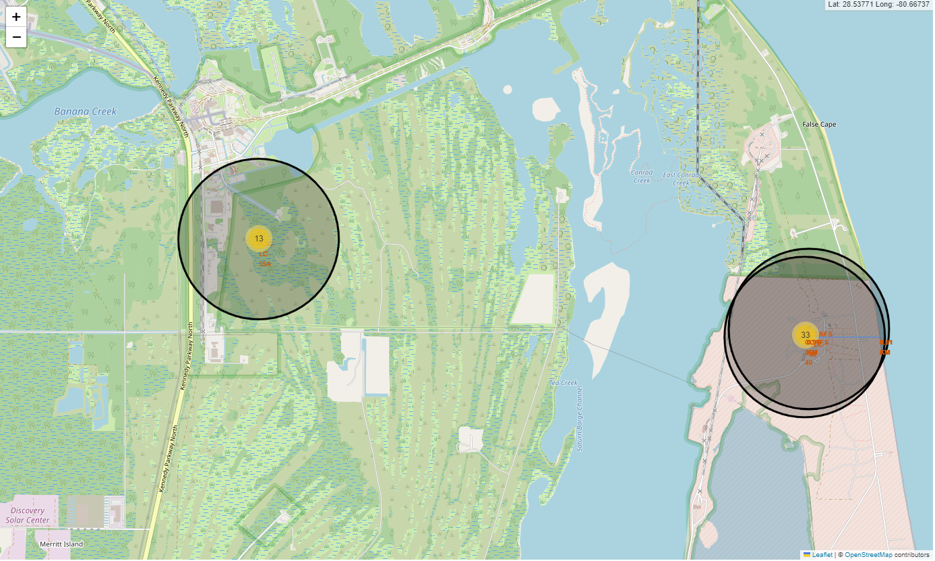
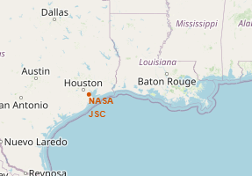
Launch Site Overview
VAFB SLC-4E
KSC LC-39A
CCAFS LC-40 & CCAFS SLC-40
One site is located on the California coast (VAFB SLC-4E), while the other three sites are located on the Florida coast
The closeup view shows the location of sites present in Florida
NASA has a site in Houston, which was not included in this study

Slide 36
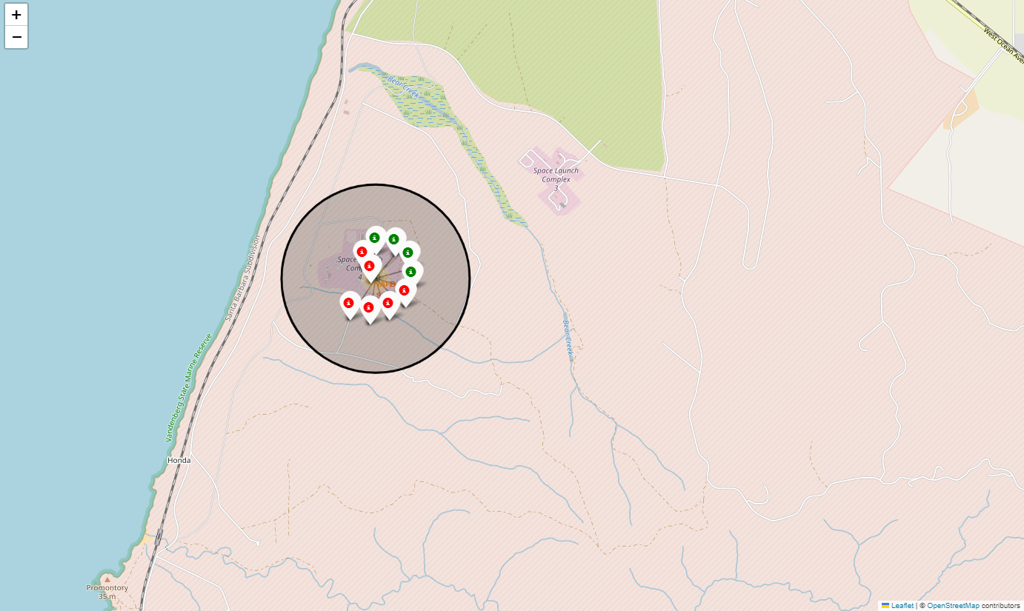
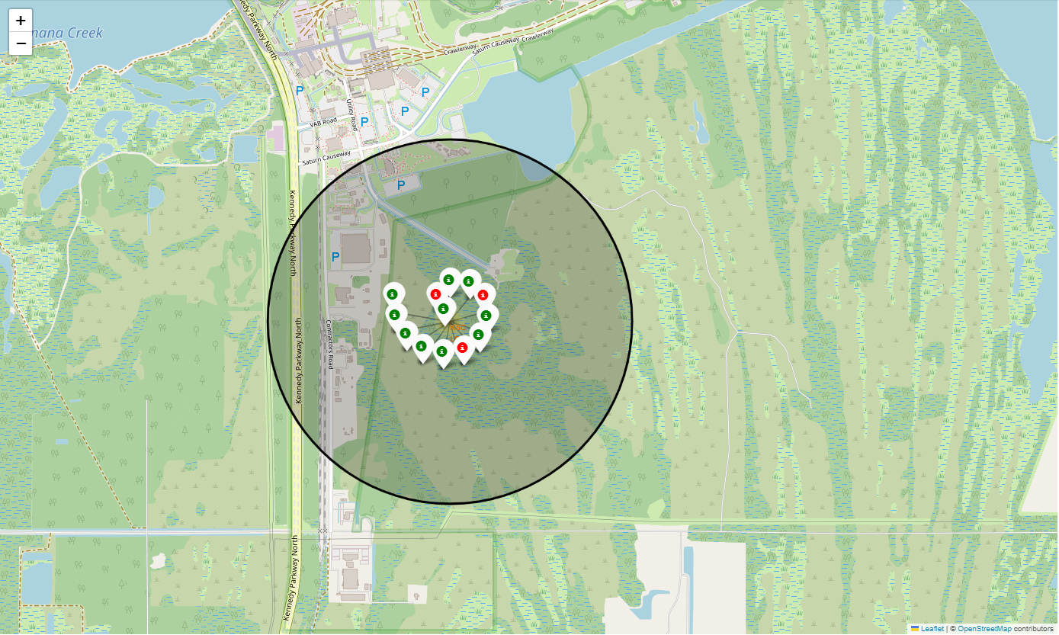
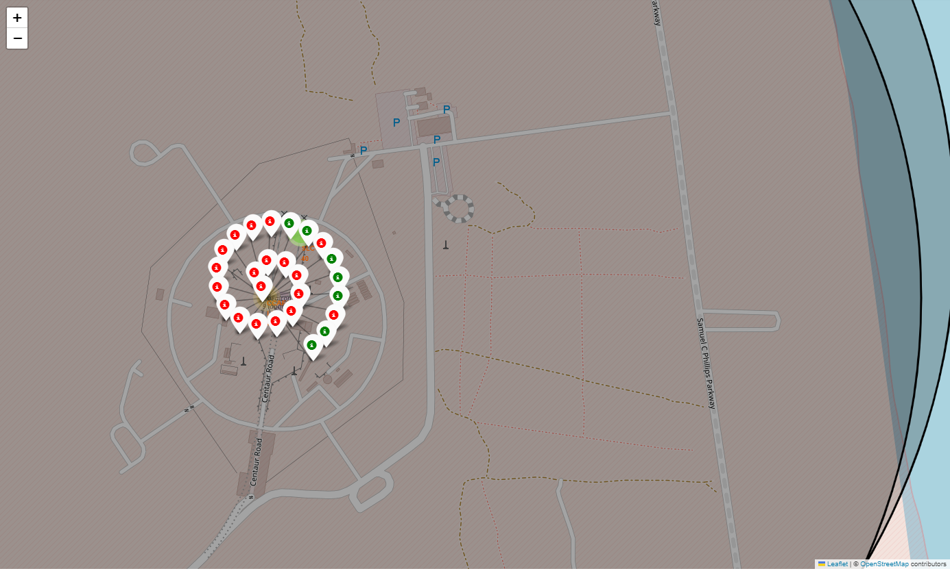
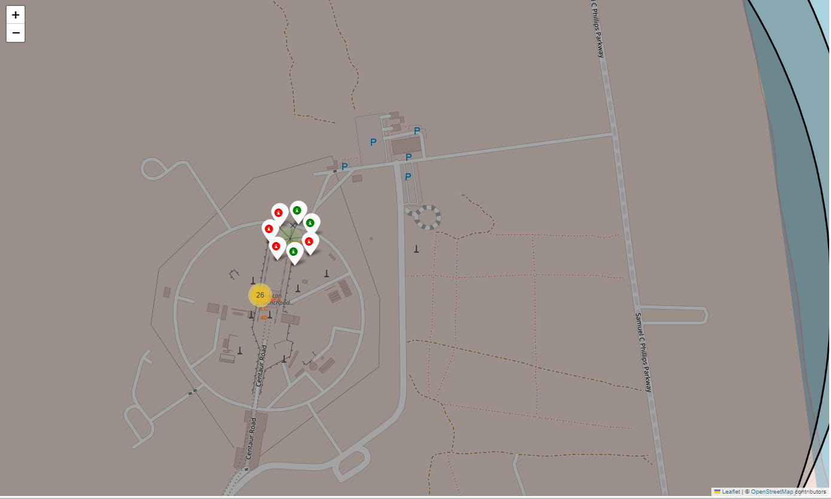
Launch Site Details
CCAFS LC-40
VAFB SLC-4E
KSC LC-39A
Closeup views of each launch site show the number of successful launches (green) and failed launches (red).
KSC LC-39A in Florida has the highest percentage of successful launches
CCAFS LC-40 in Florida has the highest percentage of failed launches
CCAFS SLC-40

Slide 37
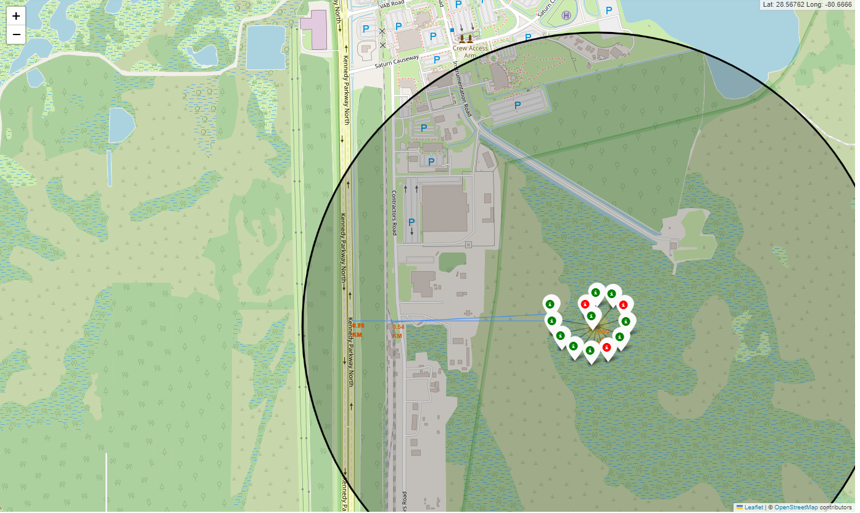
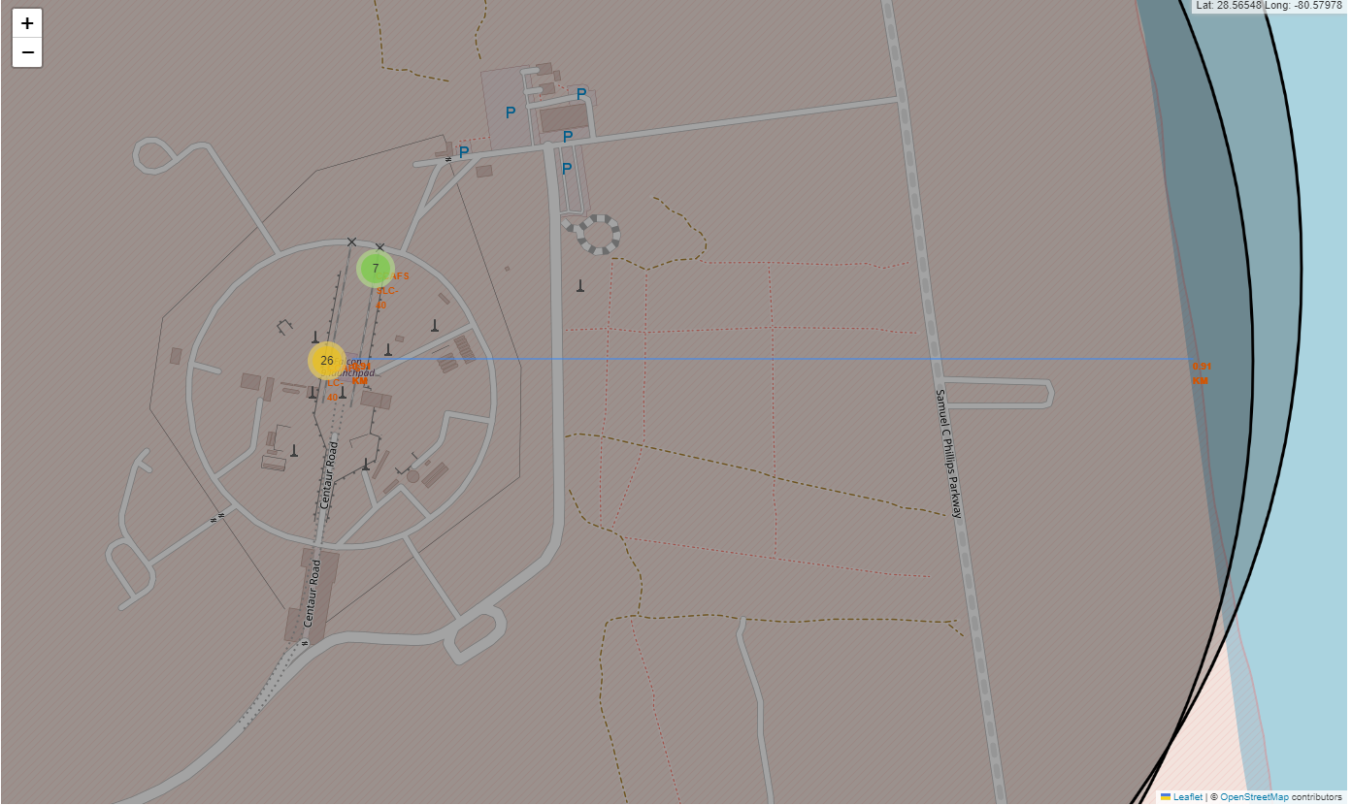
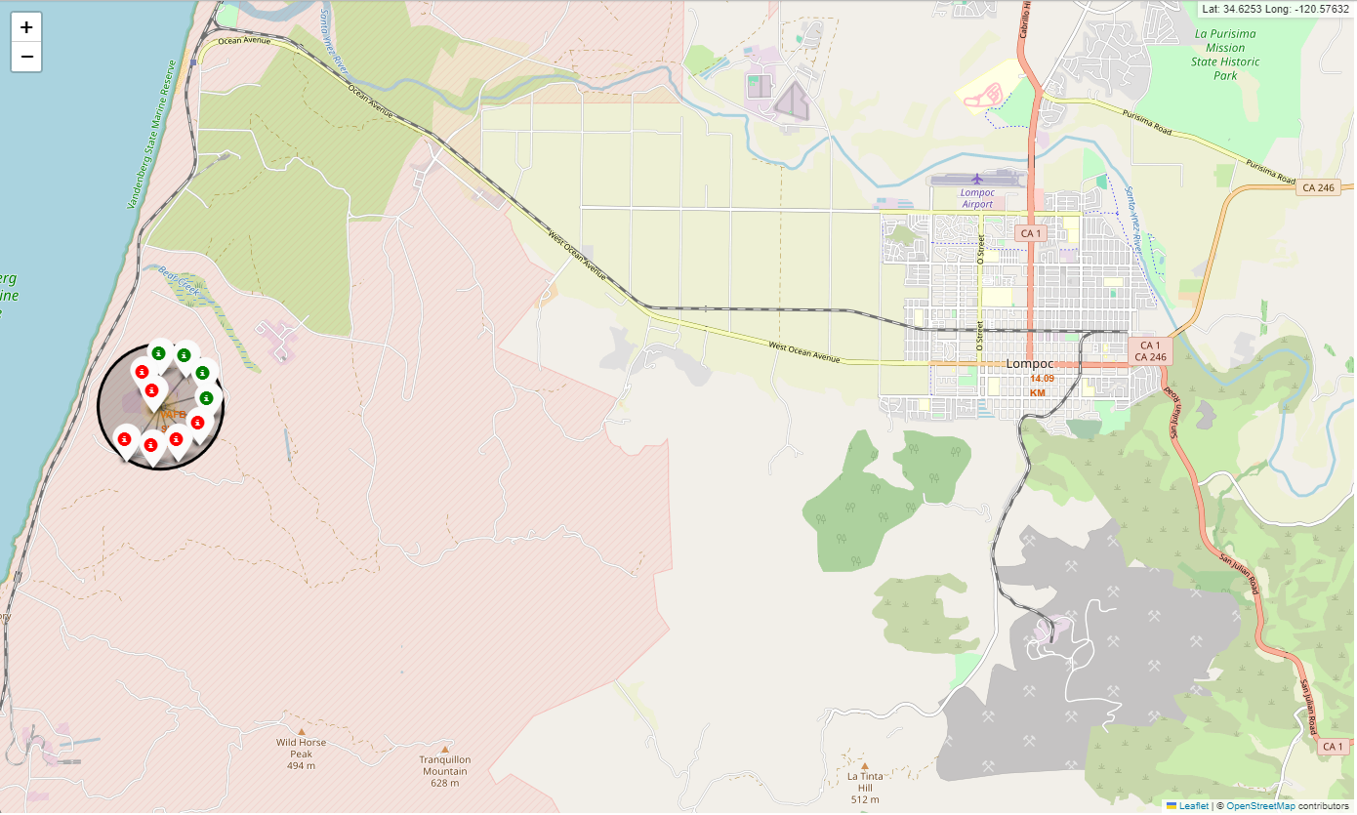
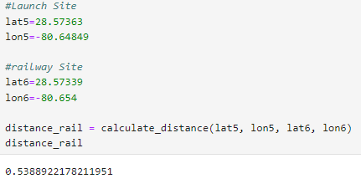
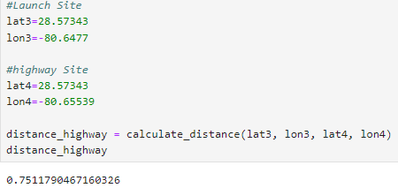
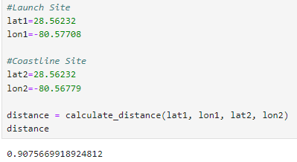
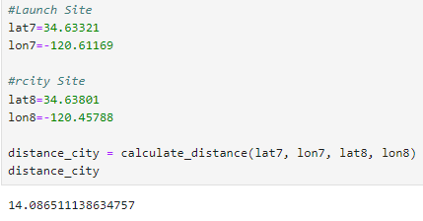
Proximity to Launch Sites
Each launch site was evaluated for proximity to major map features
It’s common for launch sites to be within one mile of coastlines, railways, and major highways
Cities are typically over 14 miles away from launch sites

Slide 38

Section 4

Slide 39
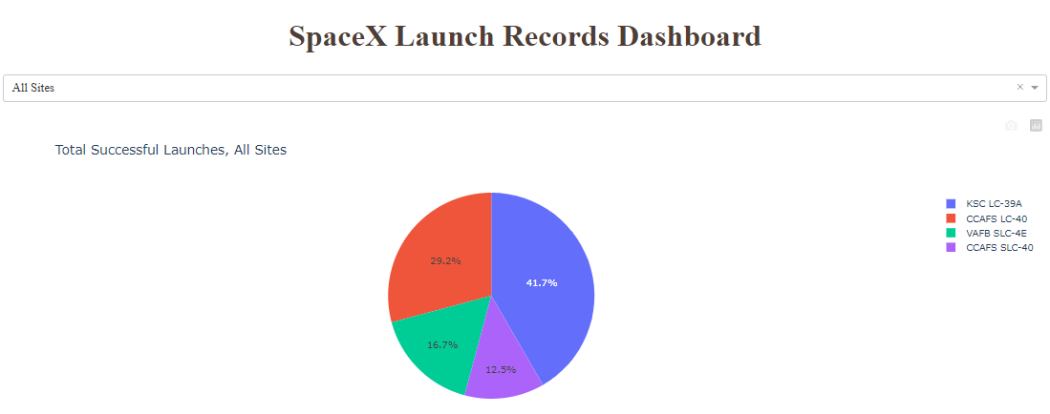
SpaceX Launch Records Dashboard
A dashboard was developed which shows the success rate for all launch sites
KSC LC-39A has the highest number of successful launches

Slide 40
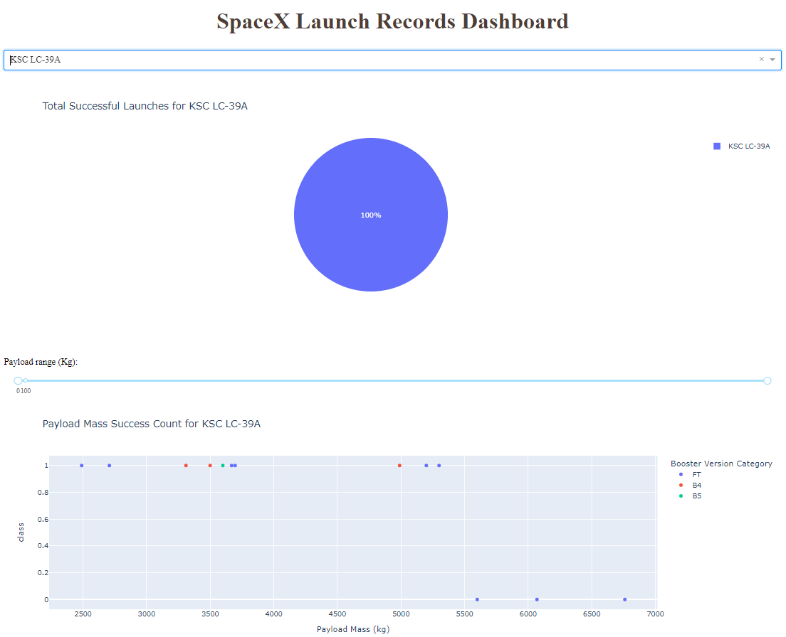
SpaceX Launch Records Dashboard
The dashboard also shows successful and failed launches by payload. The site with the most successful launches is KSC LC-39A

Slide 41
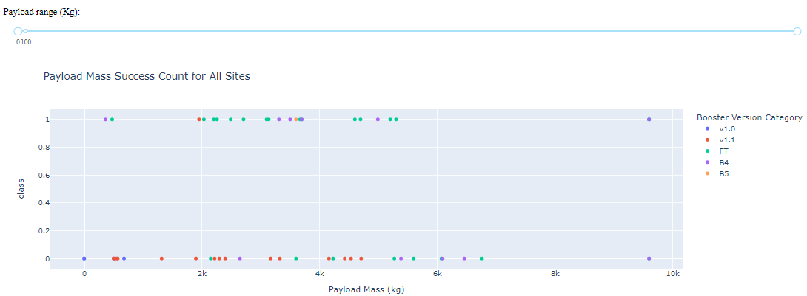
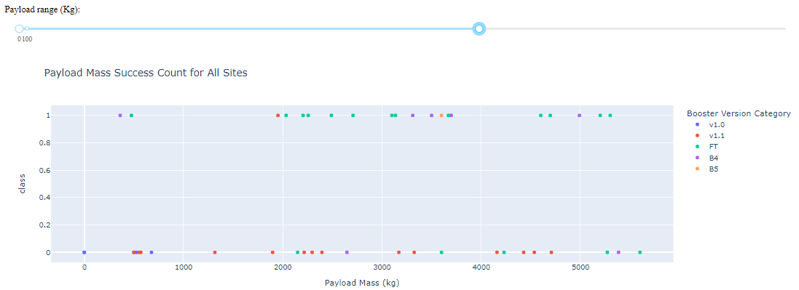
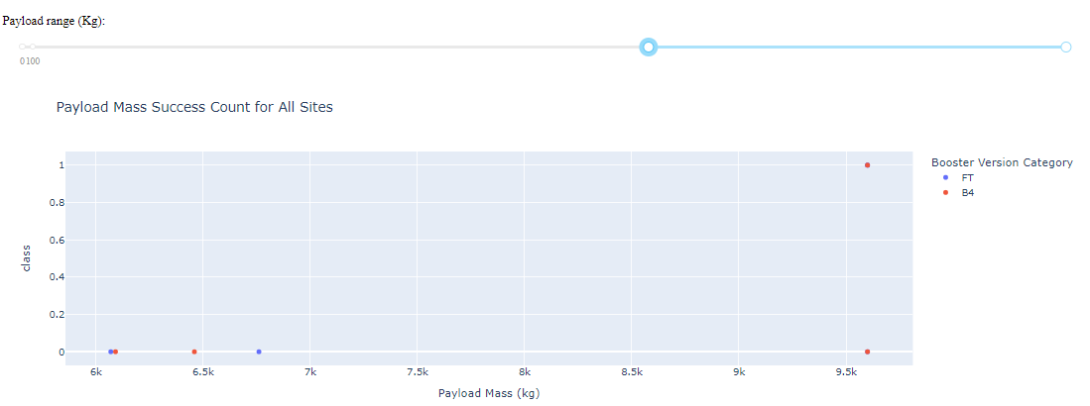
Payload Mass and Booster Versions
For all payloads, the most successes occur with the FT Booster Version
For payloads under 6000 kg, the FT Booster Version is also the most successful, with v1.1 and B5 performing poorly
For payloads above 6000 kg, the B4 Booster Version is the only one to have success, but the success rate is 1/4

Slide 42

Section 5

Slide 43
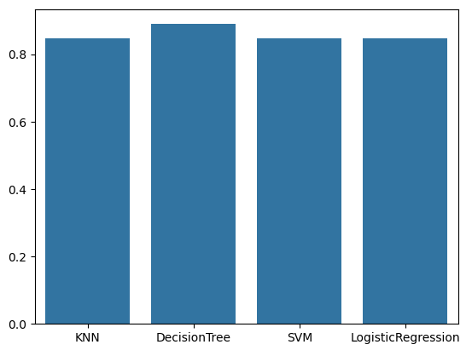
Classification Accuracy
Several models were used to analyze the SpaceX data: Decision Tree, K-Nearest Neighbor (KNN), Logistic Regression (LR), and Support Vector Machines (SVM).
Each model was compared to find the highest classification accuracy.
For this study, Decision Tree analysis yields the highest classification accuracy

Slide 44
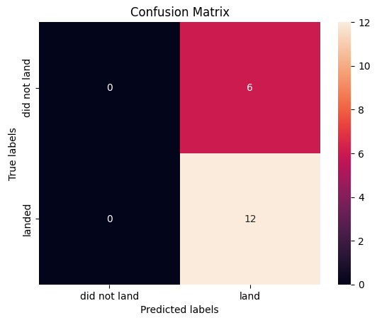
Confusion Matrix
The confusion matrix for Decision Tree analysis show no false positives and correctly sorts the data by class (successes and failures)

Slide 45
Conclusions
Decision Tree Analysis is the best model for this data set
The first successful landing for SpaceX was in December of 2015, with successful launch numbers increasing with experience
The F9 Booster has success in drone ship and where the payload mass is between 4000 and 6000 kg
The F9 Booster has also been able to carry the maximum payload mass
Overall, success is higher when payload mass is lighter
For payloads above 6000 kg, the B4 Booster Version is the only one to have success, but the success rate is low with one out of four launches being successful
The site KSC LC-39A has the most successful launches
The F9 Booster type FT has the most successes at payloads below 6000 kg
ES-L1, GEO, HEO, and SSO orbits are the most successful

Slide 46


